Slide 1
Airline Analysis
Alex Sherman

Slide 2
Analysis overview
Profit
Outline of profitability across the group.
Analysis of profitability across different customers and brands.
Brand differentiation
Is each brand attracting the same or different customers?
What features differentiate customers?
Recommendations
Our client is increasing media spending next year by 20%.
Where should that additional spend go?

Slide 3
Overview of data
Booking data
Media Spend Data
PASSENGER_ID | 290344686
BOOKING_DATE | 1/01/2012
FLIGHT_NUMBER | SA
FLIGHT_DEPARTURE_DATE | 13-Jan-13
PASSENGER_ZIP_CODE | 2075
PASSENGER_COUNTRY_CODE | AUS
AGE | 55
BOOKING_TRAVEL_AGENCY_ZIP_CODE | 2022
AIR_FLIGHT_COMPANY_NAME | A
GENDER_CODE | M
PROFIT (AUD) | 2909.79
Category | Airlines
Company | A
Market | National
Media Type | Magazines
1/01/2012 | 30
1/02/2012 | 30
1/03/2012 | 10
1/04/2012 | 30
1/05/2012 | 48
1/06/2012 | 48
1/07/2012 | 20
1/08/2012 | 5
1/09/2012 | 26
1/10/2012 | 30
1/11/2012 | 20
1/12/2012 | 39
Notes:
Approximately 50,000 booking
Companies A, B and C

Slide 4
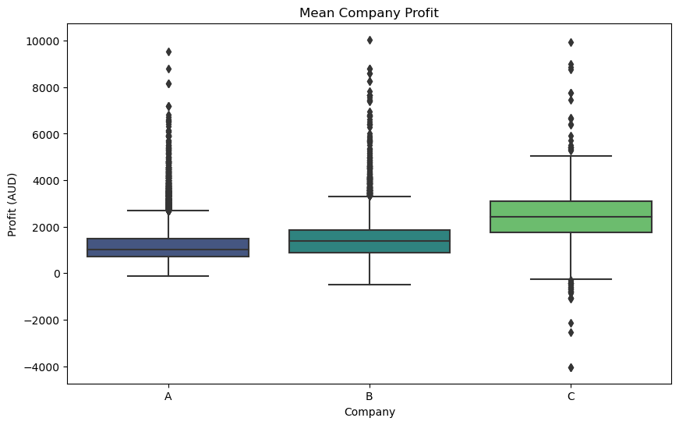
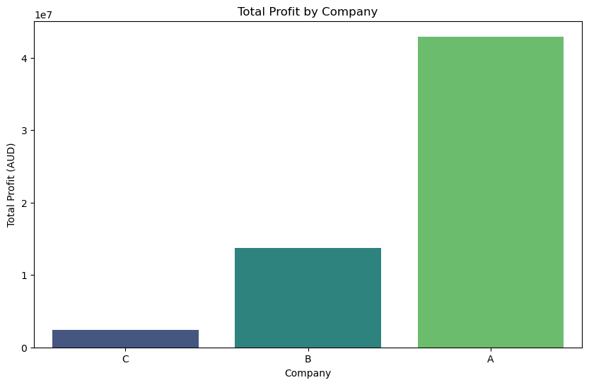
Profitability analysis

Slide 5
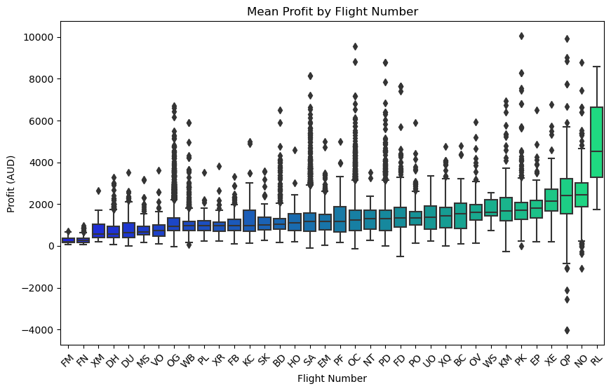
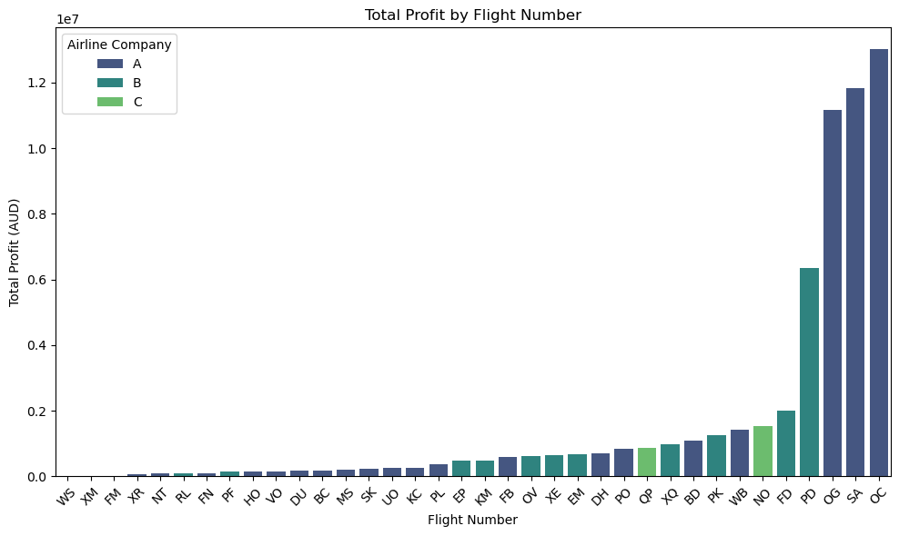
Diving into flight numbers
Notes:
RL highest mean but very little over all profit( would probably regress to the mean.
QP and NO likewise have slightly higher means but also massive variance… They also appear to be operating at a loss occasionally. Lets have a closer look at that…

Slide 6
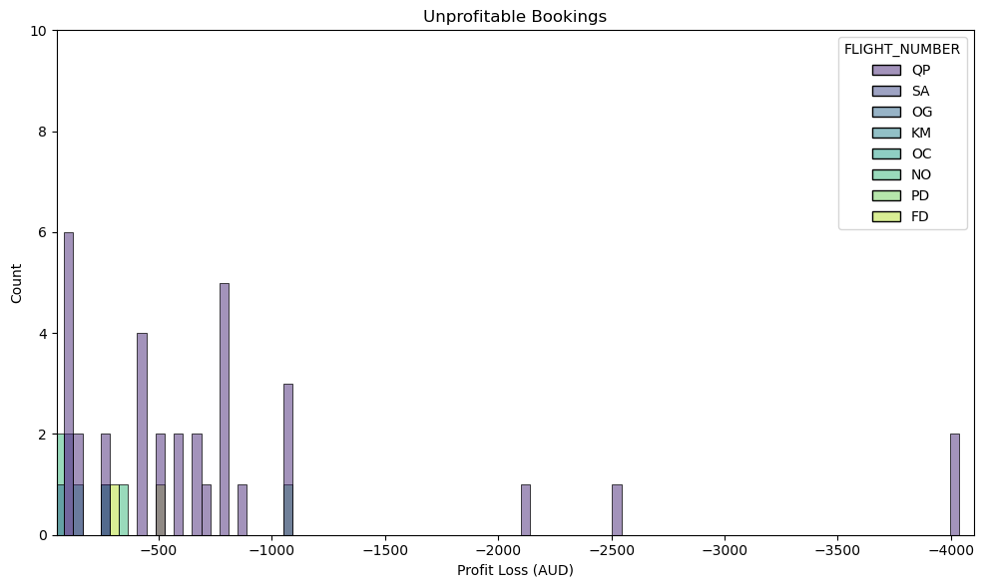
What flights are costing money?
PASSENGER ID | BOOKING DATE | FLIGHT NUMBER | FLIGHT DEPARTURE DATE | PASSENGER COUNTRY CODE | AGE | AIR FLIGHT COMPANY NAME | PROFIT (AUD)
463672038 | 5/01/2012 | QP | 26/03/2012 | AUS | 64 | C | -4036.83
476937378 | 17/01/2012 | QP | 26/03/2012 | AUS | 78 | C | -1070.79
445974627 | 19/01/2012 | QP | 26/03/2012 | AUS | 68 | C | -4031.2
438761494 | 24/01/2012 | QP | 26/03/2012 | AUS | 62 | C | -1060.66
499338190 | 30/01/2012 | QP | 26/03/2012 | AUS | 70 | C | -1057.03
502820523 | 30/01/2012 | QP | 26/03/2012 | AUS | 83 | C | -2131.64
828248961 | 8/02/2012 | QP | 26/03/2012 | AUS | 80 | C | -2541.13
Notes:
The QP flight on 2012-03-26 in particular appears to have operated at a large loss (mean profit -$1225).
The QP flight appears to be of note in regards to unprofitability. 8.9% of these flights were unprofitable.

Slide 7
Majority of profit is generated by few flight numbers
The top 3 profit producers belong to company A.
The top 4 are producing 72% of all profits!

Slide 8
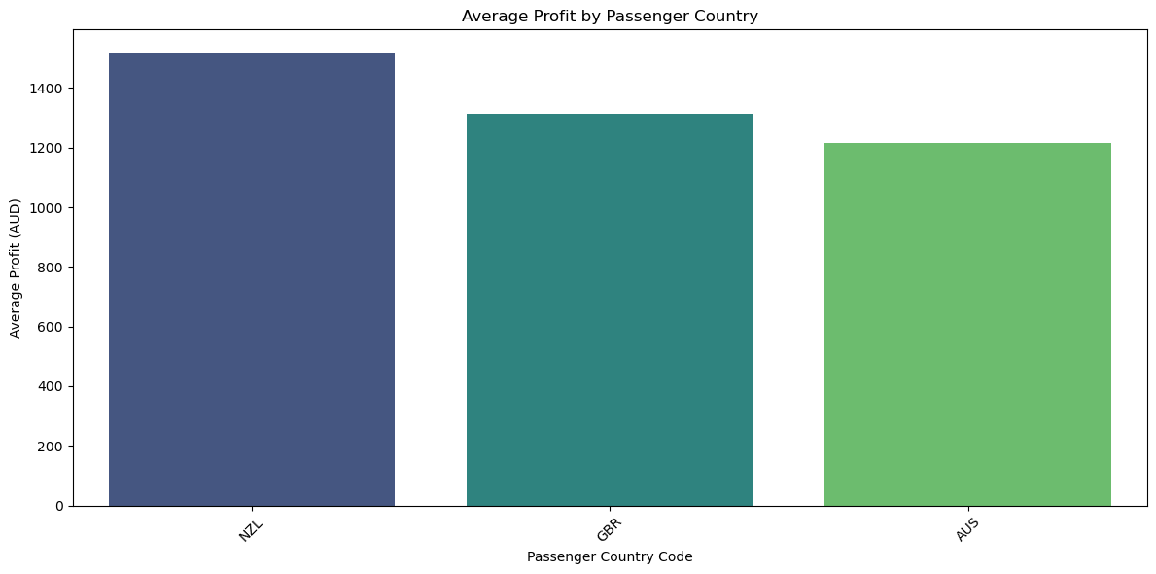
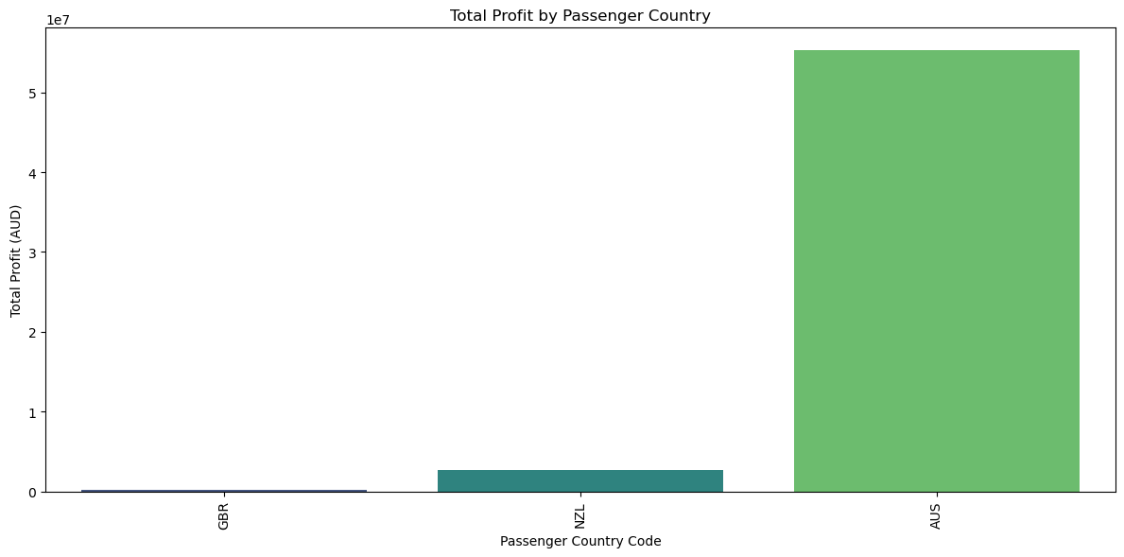
How does geography influence profit?
Notes:
The vast majority of profit was made in aus
Media spend was also only in aus
I’ll continue to just look at profit by aus geography

Slide 9
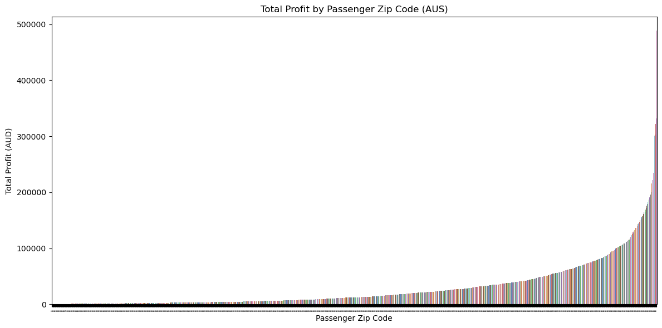
Profit by passenger zip-code
220 of 1856 (12%) zip codes are producing approximately 50% of the total Australian profit.
Notes:
(bottom-up)

Slide 10
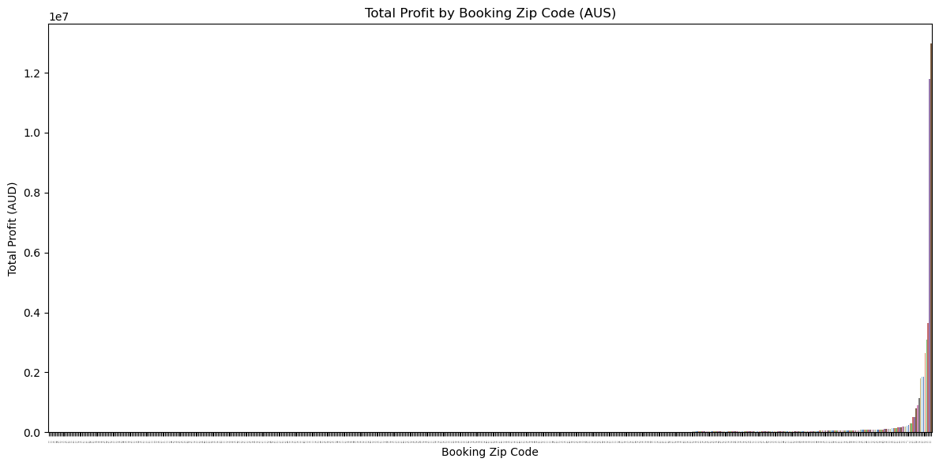
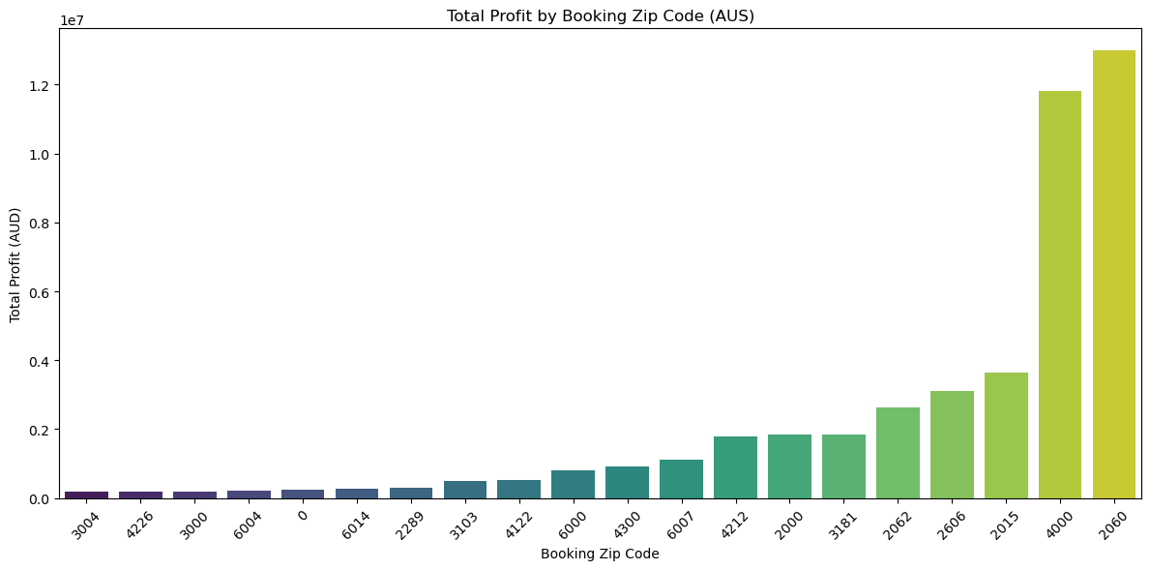
Profit by travel desk zip code
8 of 586 (1.4%) booking travel desk zip codes are producing approximately 70% of the total Australian profit. Those zip codes are below.
The top two, 2060 (North Sydney) and 4000 (Brisbane), alone are responsible for 45% of the profits alone!

Slide 11
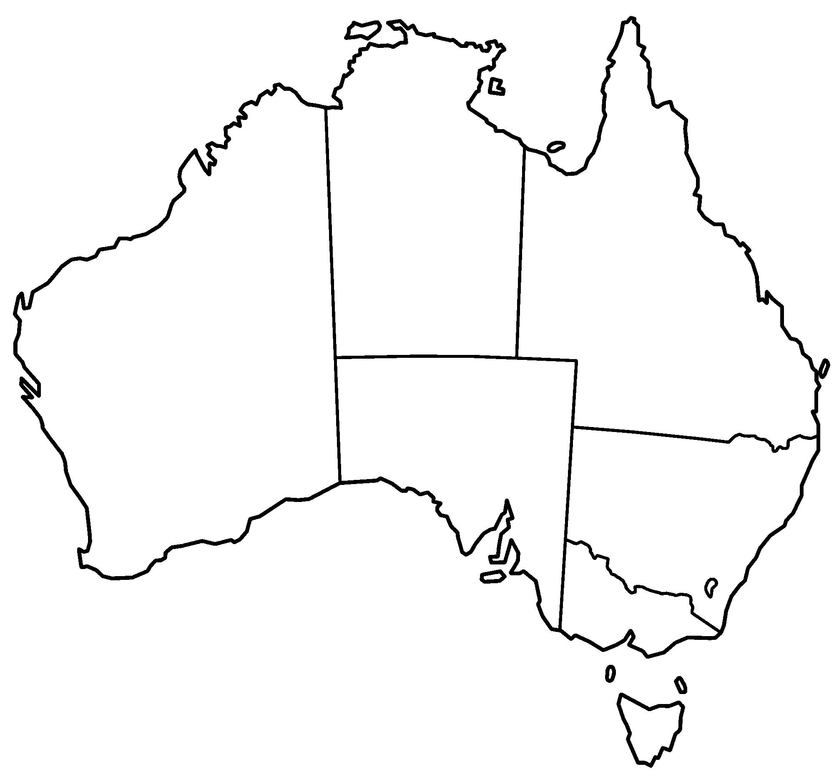
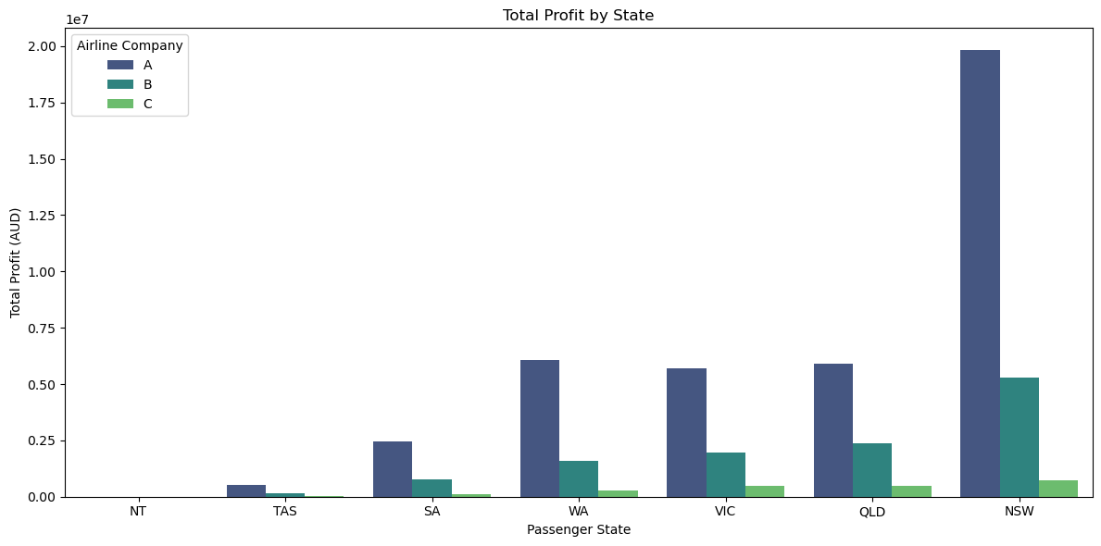
Profit Nation Wide
Profit percentage by state
16%
15%
6%
47%
15%
1%

Slide 12
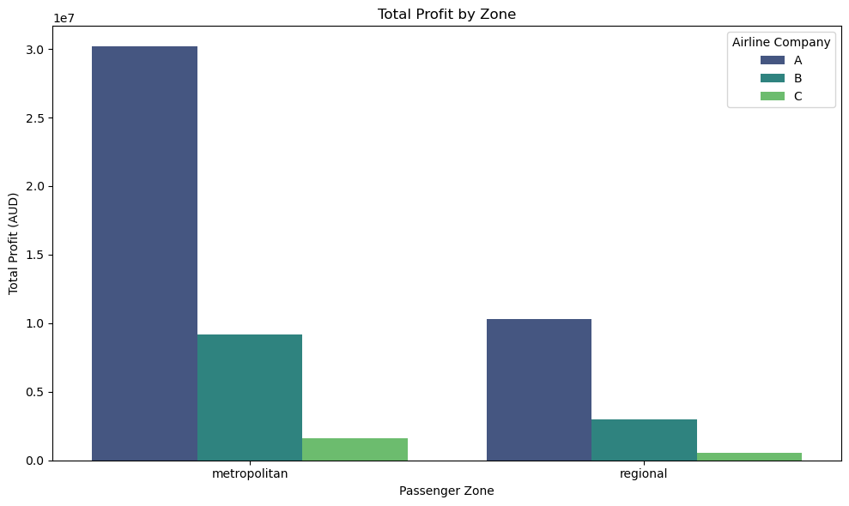
Profit by region
Notes:
Therefore 75% of total profit is coming from metropolitan sales.
Although this number was an estimate given the data and the cross-referencing of sources, this is surprisingly lower than the percentage of urban dwellers in Aus which is 86%.

Slide 13
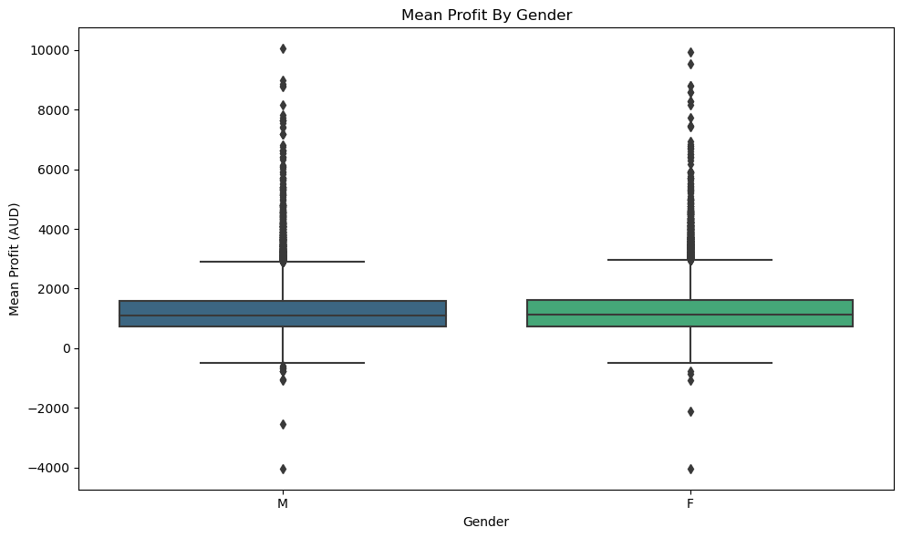
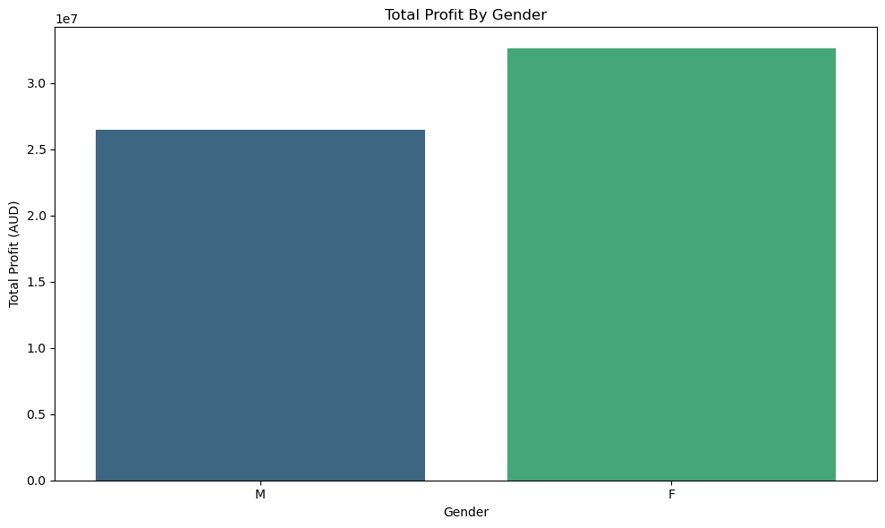
What about gender and age?
45%
55%

Slide 14
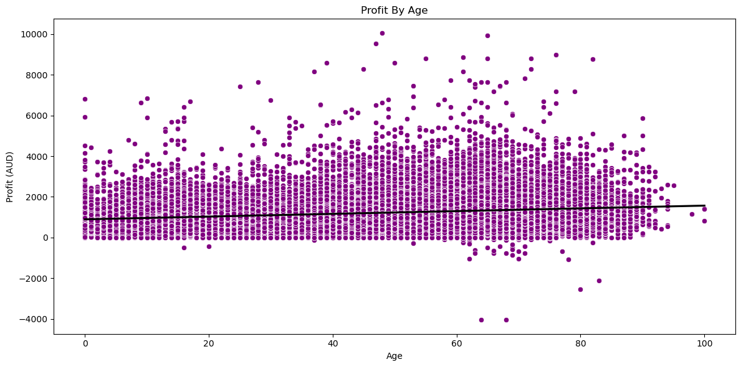
Profit by age

Slide 15
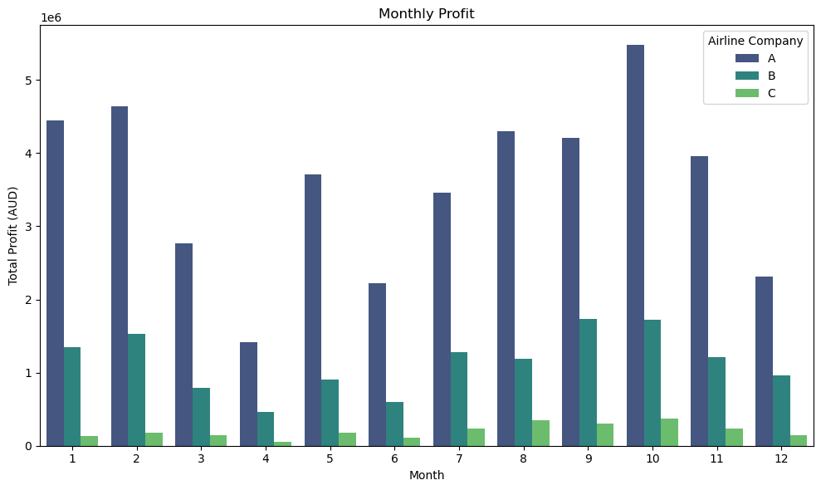
Profit by booking month

Slide 16
Profit take aways
Company A was by far the most profitable brand
NSW was by far the most profitable state
The profit produced by passenger and travel desk zip code is isolated to a few areas

Slide 17
Part 2 – Brand differentiation
A
C
B
11%
1%
4116
432
43%
43%
111
1%
11%

Slide 18
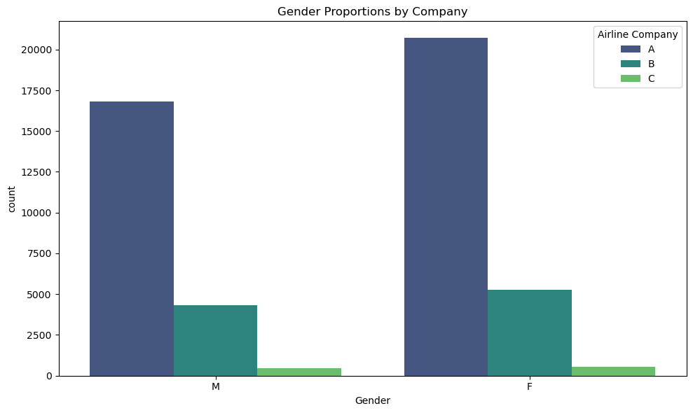
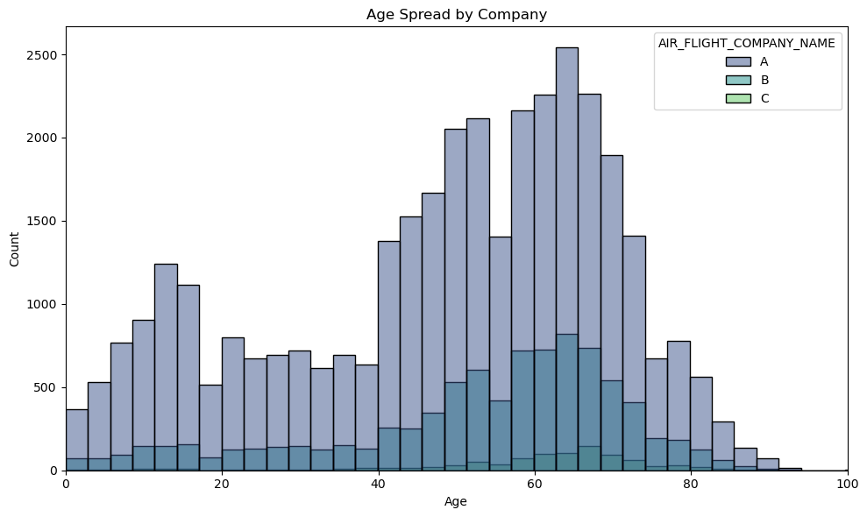
Gender and Age
Notes:
Nothing remarkable in gender
Age spread sees a peak in the young market for A.
I think this is a family ting.
Mean age for each is A 48, B 53 and C 60

Slide 19
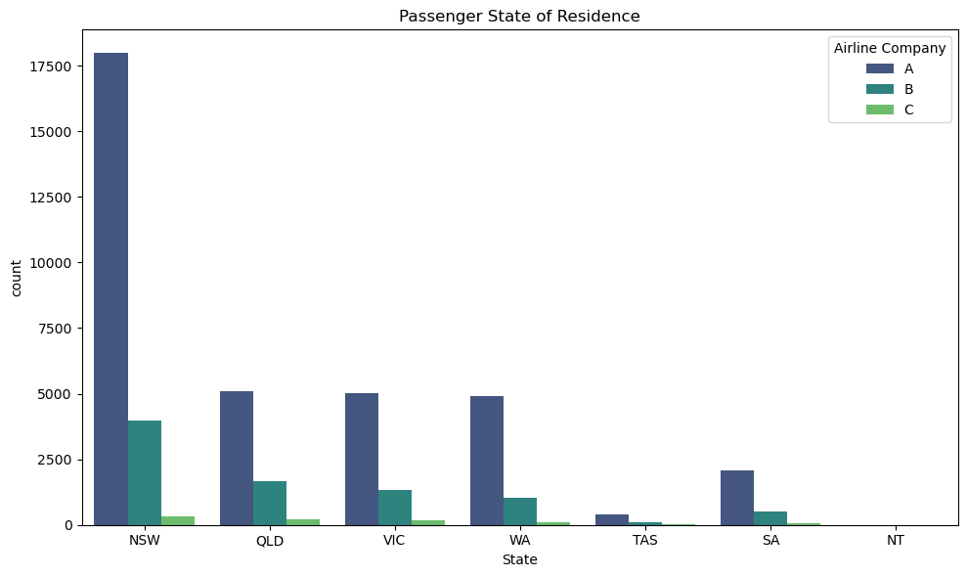
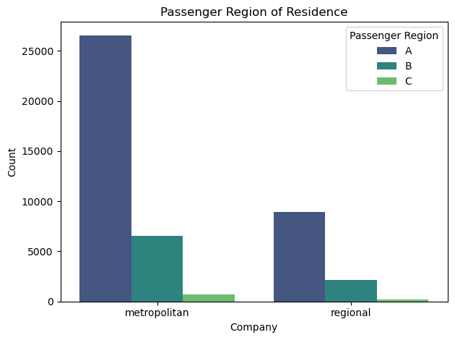
Geographical
75%
75%
76%
Notes:
Airline A had a greater portion of passengers from NSW and metro areas

Slide 20
Demographics take aways
Brand A may be attracting more families.

Slide 21
Part 3 – Recommendations
To make recommendations it is important to understand what media spend is working for our client.
As such:
I combined all the monthly media spends into one annual media spend.
This media spend was divided by state and airline brand.
Digital and magazine spend required segmentation.
Correlations were made between profit and each media spend.

Slide 22
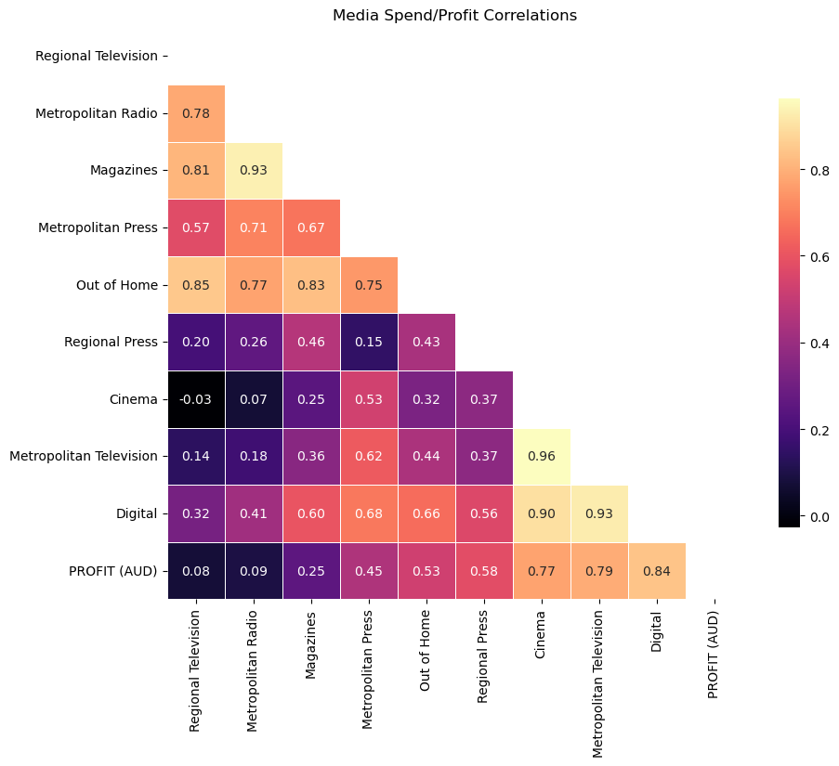
Media spend effect
Media Spend/Profit Correlations
Random Forest Approach
Feature | Importance
Digital | 0.39212
Metropolitan Television | 0.35974
Cinema | 0.10557
Out of Home | 0.06959
Regional Press | 0.03297
Regional Television | 0.01578
Metropolitan Press | 0.01327
Metropolitan Radio | 0.00575
Magazines | 0.00521

Slide 23
Advice for budget increase
 | Metro Television | % Of Metro Television Spend
South Australia | 647 | 6.880783
Western Australia | 997 | 10.603
Queensland | 1508 | 16.03744
Victoria | 3120 | 33.1809
New South Wales | 3131 | 33.29788
16%
15%
6%
47%
15%
1%

Slide 24
Advice for budget increase
Digital is most likely the way to go however media spend could also be increased in metropolitan television
It is most likely necessary to adjust media spend across states as NSW is far outperforming other states and territories
If digital media is the chosen approach. Target it toward those earlier mentioned flights and post codes of greatest profit.

